Slide 1
Planning as Inference
Matthew Botvinick, Marc Toussaint
“Planning is accomplished through probabilistic inference.”

Slide 2
Background: Why do we need a new perspective?
What is PAI(planning as inference)?
PAI applications
Implications for Neuroscience
Opportunities and Challenges

Slide 3
Background
Reward-Based Decision Making

Slide 4
Background
Reward-Based Decision Making
Habits
Goal Directed
Situation-Response Association
Planning based on prediction of outcomes

Slide 5
Background
Reward-Based Decision Making
Habits
Goal Directed
Situation-Response Association
Planning based on prediction of outcomes
TD learning & Dopaminergic signals

Slide 6
Background
Reward-Based Decision Making
Habits
Goal Directed
Situation-Response Association
Planning based on prediction of outcomes
TD learning & Dopaminergic signals
Not Clear:
What’s the information processing operations?

Slide 7
Background
Traditional Perspectives on Planning:
a specific a priori goal the generic goal of reward maximization

Slide 8
Background
Traditional Perspectives on Planning:
a specific a priori goal the generic goal of reward maximization
deterministic action outcomes: unrealisitic MDP

Slide 9
Background
Traditional Perspectives on Planning:
a specific a priori goal the generic goal of reward maximization
deterministic action outcomes: unrealisitic MDP
Dynamic Programming, Model-Based RL

Slide 10
Planning as Inference

Slide 11
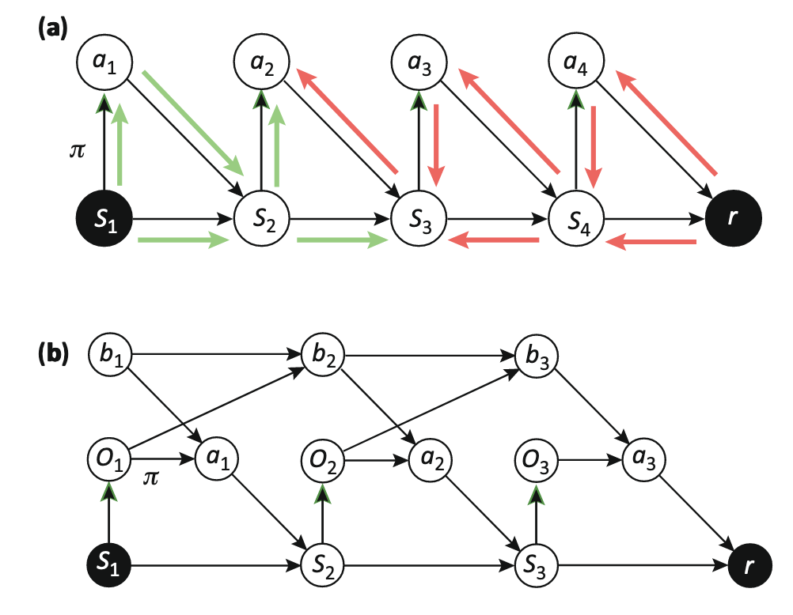
Planning as Inference
The brain/agent has a generative model of the world
a joint probability distribution over actions, outcome states, and rewards

Slide 12
Planning as Inference
The brain/agent has a generative model of the world
Condition on reward: assume reward✅, what’s the
most probable action/policy that had been taken ?
0.1
S2
(reward!)
a1
S1
0.9
0.6
a2
0.4
S1

Slide 13
Planning as Inference
The brain/agent has a generative model of the world
Condition on reward: assume reward✅, what’s the
most probable action that had been taken ?
Probabilistic Inference/ Inverse Inference

Slide 14
Dynamic Programming, Model-Based RL:
Forward-looking, Value optimization
Planning as Inference(PAI):
Backward-looking, Probabilistic Inference

Slide 15

PAI applications
Success in Machine Learning and Robotics
Discover optimal solutions more quickly
Tackle complex problems(otherwise intractable)

Slide 16
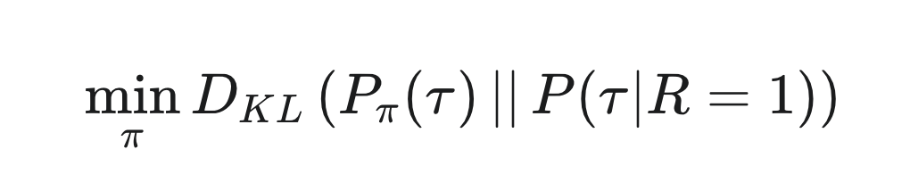
PAI applications
Two Critical Developments in PAI theory:
Rigorous Mathematical Formulations:
Efficient Algorithms(e.g. EM)

Slide 17
PAI applications
E-step(expectation/inference)
Estimate the posterior distribution
of optimal trajectories, q(τ),
given the current policy π_k.
inverse inference
the improved policy
M-step(maximization/planning)
Update the policy to π_k+1
to minimize the KL divergence
with the estimated posterior q(τ)
the ideal distribution

Slide 18
PAI applications
“message passing” in the generative model
Decentralized, Localized
Iterative Procedure
forward messages
update policy
backward messages

Slide 19
Implications
PAI
“all cognitive and neural computation can be understood in terms of probabilistic inference”
Planning

Slide 20
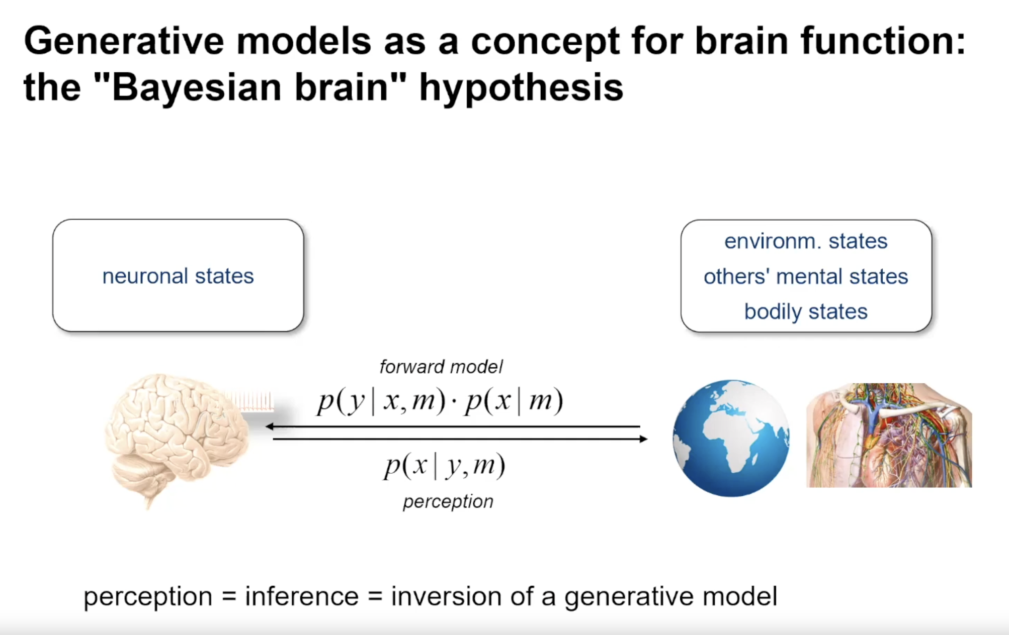
Implications
PAI
“all cognitive and neural computation can be understood in terms of probabilistic inference”
Planning
Bayesian theories of visual perception

Slide 21
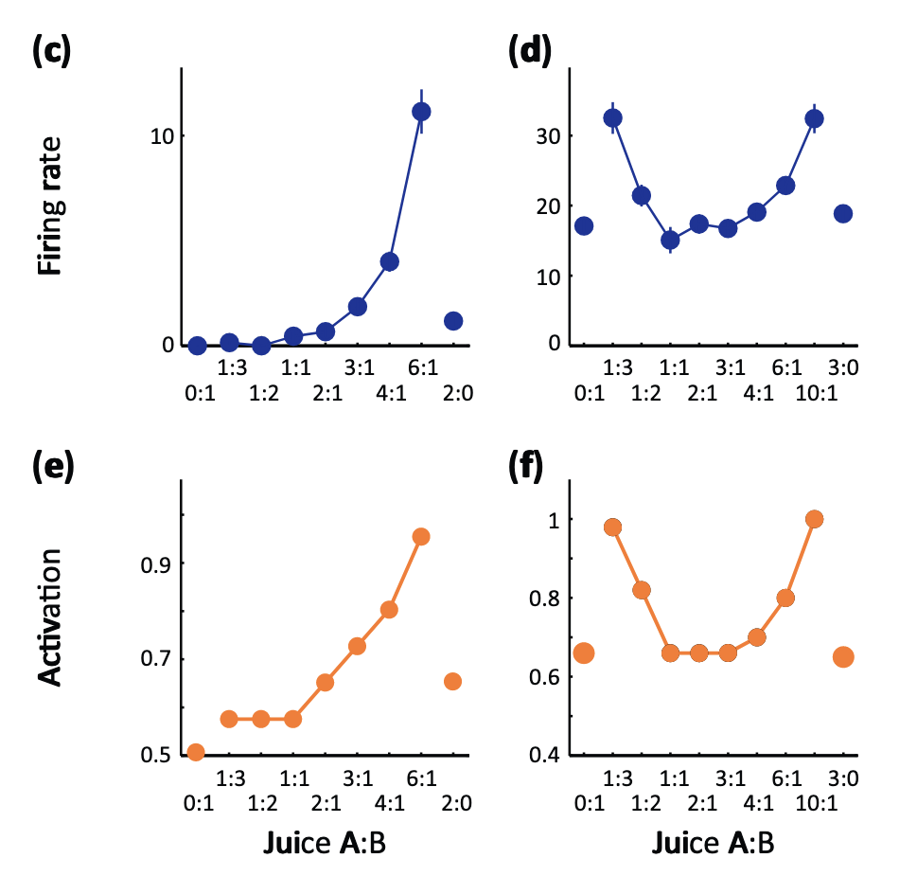
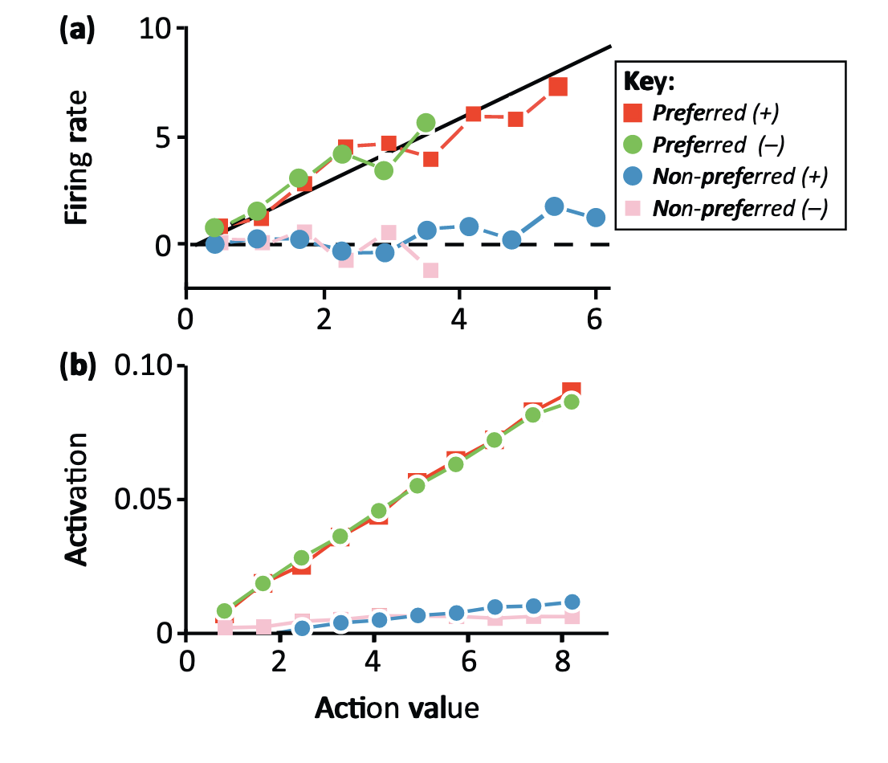
Implications
Neural Evidence:
recorded data
neural network model,
PAI implemented

Slide 22
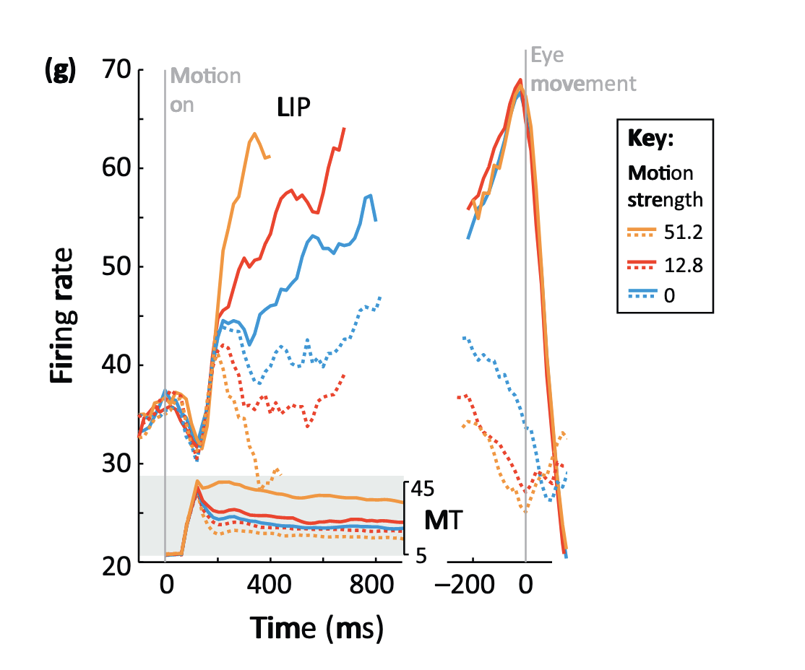
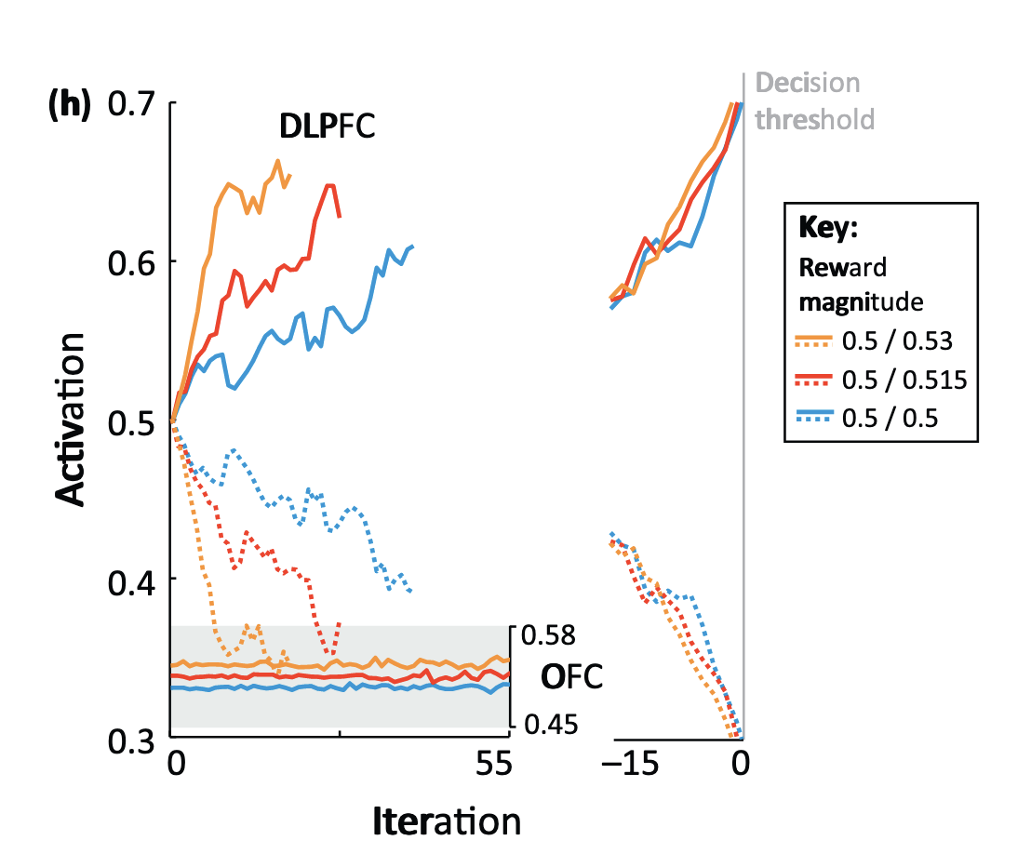
Implications
Neural Evidence:
Iteration
(integration of momentary evidence)
neural network model,
PAI implemented

Slide 23
Opportunities and Challenges
current work on PAI mostly theoretical
empirical evidence?

Slide 24
Opportunities and Challenges
current work on PAI mostly theoretical
empirical evidence?
“planning occurs under strict capacity limitations”(bounded rationality)
In ML: approximation techniques(e.g. sampling based)
approximation applied to PAI might offer new insights

